Slide 1
Global Attention, Local Attention and Supervised Attention
Quan Du
2017.6.24

Slide 2
Effective Approaches to Attention-based Neural Machine Translation

Slide 3


Basic Framework of NMT
$$−\sum_{i}{\log{p(y^{i}|x^{i};θ)}}$$
$$p(y|x;θ)$$
Encoder
Decoder
Hidden
neural
machine
translation
</s>
Softmax
…
…
…
…
Attention
…
…
…
…
神经
机器
翻译
</s>
<s>
neural
machine
translation

Slide 4
Encoder
Encoder
Encoder
Hidden
…
…
…
…
2M*M
…
…
…
…
Node(N)
M*N
Embedding(M)
V*M
One-hot(V)
神经
机器
翻译
</s>
神经
机器
翻译
</s>

Slide 5
Node
Encoder
Hidden
…
…
…
…
神经
机器
翻译
</s>

Slide 6
Node
Encoder
Hidden
…
…
…
…
神经
机器
翻译
</s>

Slide 7
Node
Encoder
Hidden
…
…
…
…
神经
机器
翻译
</s>

Slide 8
Node
Encoder
Hidden
…
…
…
…
神经
机器
翻译
</s>

Slide 9
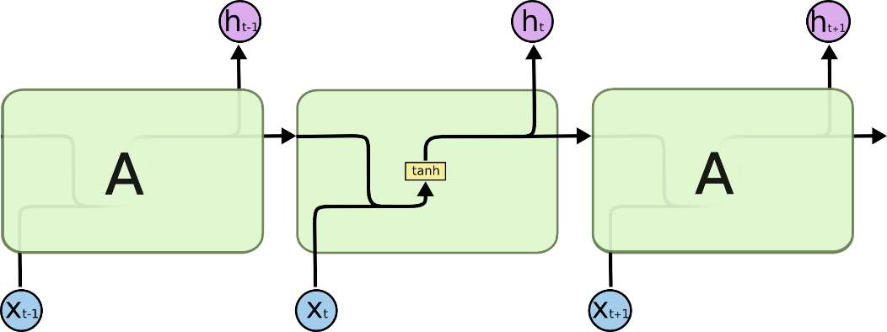
Node
Encoder
Hidden
…
…
…
…
神经
机器
翻译
</s>

Slide 10

LSTM
Encoder
Hidden
…
…
…
…
神经
机器
翻译
</s>

Slide 11
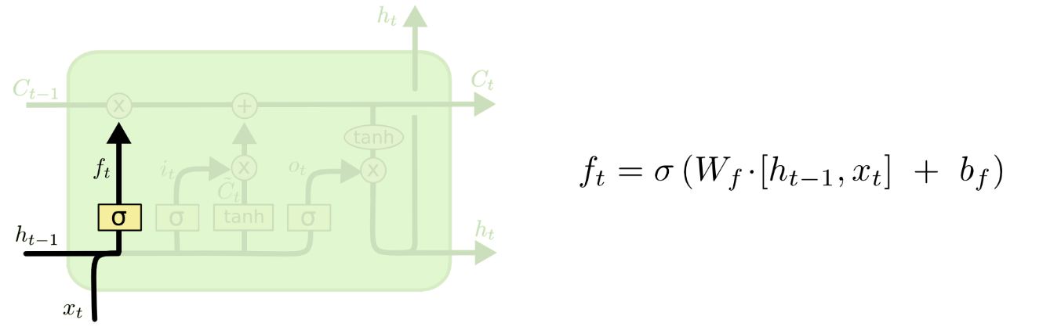
LSTM
Encoder
Hidden
…
…
…
…
神经
机器
翻译
</s>

Slide 12
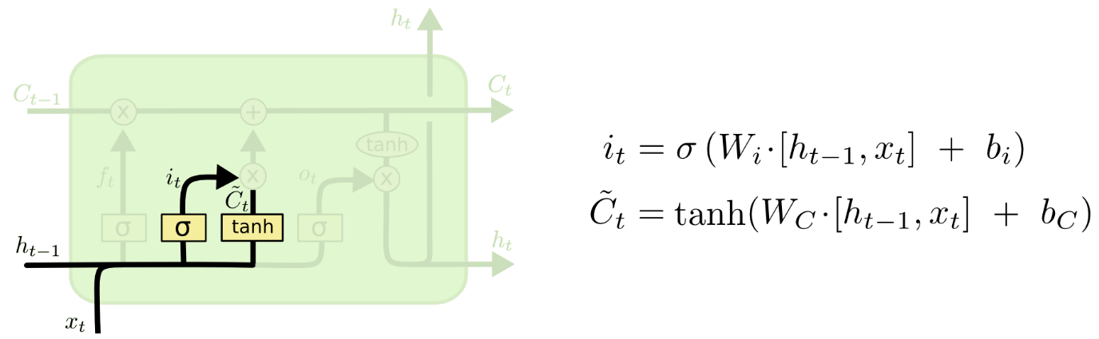
LSTM
Encoder
Hidden
…
…
…
…
神经
机器
翻译
</s>

Slide 13
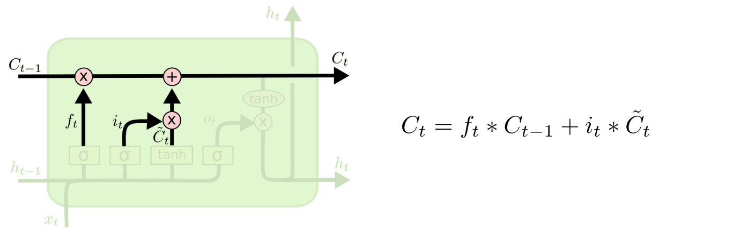
LSTM
Encoder
Hidden
…
…
…
…
神经
机器
翻译
</s>

Slide 14
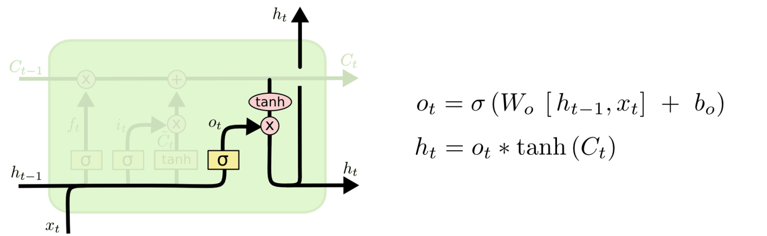
LSTM
Encoder
Hidden
…
…
…
…
神经
机器
翻译
</s>

Slide 15
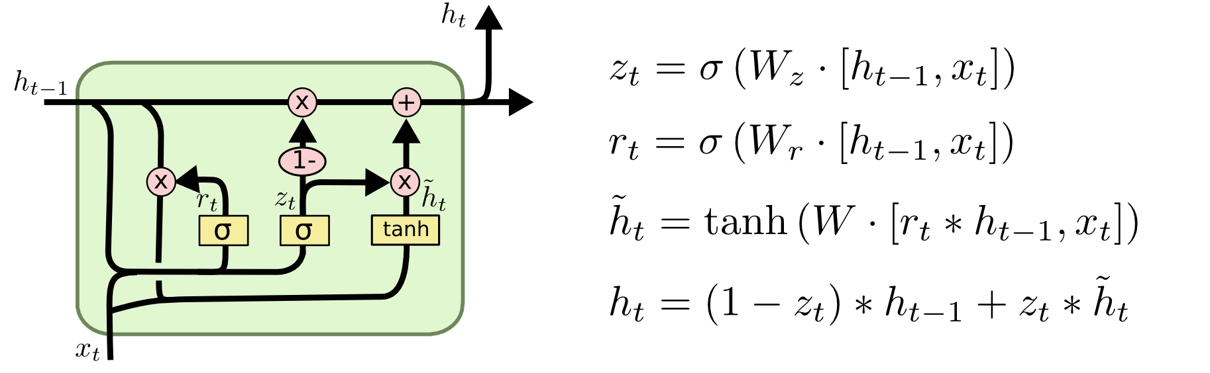
GRU
Encoder
Hidden
…
…
…
…
神经
机器
翻译
</s>

Slide 16
Hidden state
Encoder
Hidden
…
…
…
…
…
…
神经
机器
翻译
</s>

Slide 17
Decoder
Decoder
Decoder
neural
machine
translation
</s>
Softmax
…
…
…
…
Attention
Node(N)
M*N
…
…
…
…
Embedding(M)
V*M
One-hot(V)
</s>
neural
machine
translation
<s>
neural
machine
translation

Slide 18
Attention
Decoder
神经
neural
machine
translation
</s>
Softmax
机器
Attention
翻译
…
…
…
…
</s>
<s>
neural
machine
translation

Slide 19
Attention
Decoder
神经
neural
0.95
Softmax
机器
0.02
Attention
翻译
0.02
0.01
…
</s>
<s>

Slide 20
Attention
Decoder
神经
machine
0.02
Softmax
机器
0.95
Attention
翻译
0.02
0.01
…
</s>
neural

Slide 21
Attention
Decoder
神经
translation
0.02
Softmax
机器
0.02
Attention
翻译
0.95
0.01
…
</s>
machine

Slide 22
Attention
Decoder
神经
</s>
0.01
Softmax
机器
0.02
Attention
翻译
0.02
0.95
…
</s>
translation

Slide 23






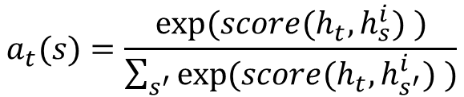

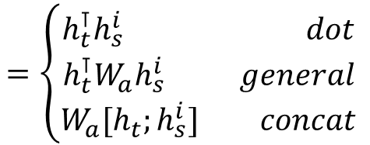
Global Attention
$$=\left\{\begin{matrix}\begin{matrix}{h_{t}^{⊺}h}_{s}^{i} & dot\end{matrix} \\ \begin{matrix}{h_{t}^{⊺}W_{a}h}_{s}^{i} & general\end{matrix} \\ \begin{matrix}W_{a}[{h_{t};h}_{s}^{i}] & concat\end{matrix}\end{matrix}\right.$$
$$h_{s}$$
$${score(h}_{t},h_{s}^{i})$$
神经
$$h_{s}^{1}$$
???
机器
$$h_{s}^{2}$$
???
A
翻译
$$h_{s}^{3}$$
???
$$h_{t}$$
$$a_{t}(s)=\frac{exp⁡({score(h}_{t},h_{s}^{i}) )}{\sum_{s^{′}}{exp⁡({score(h}_{t},h_{s^{′}}^{i}) )}}$$
???
…
</s>
$$h_{s}^{4}$$
<s>

Slide 24




Global Attention
$$h_{s}$$
神经
$$h_{s}^{1}$$
$$a_{t}^{1}$$
机器
$$h_{s}^{2}$$
$$a_{t}^{2}$$
A
翻译
$$h_{s}^{3}$$
$$a_{t}^{3}$$
$$h_{t}$$
$$a_{t}^{4}$$
…
</s>
$$h_{s}^{4}$$
<s>

Slide 25

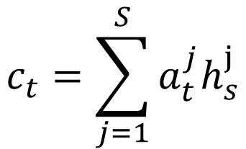



Global Attention
$$h_{s}$$
神经
$$h_{s}^{1}$$
$$a_{t}^{1}$$
$$c_{t}=\sum_{j=1}^{S}{a_{t}^{j}h_{s}^{j}}$$
$$a_{t}^{2}$$
C
机器
$$h_{s}^{2}$$
A
$$a_{t}^{3}$$
翻译
$$h_{s}^{3}$$
$$h_{t}$$
$$a_{t}^{4}$$
…
</s>
$$h_{s}^{4}$$
<s>

Slide 26
Local Attention
$$h_{s}$$
神经
$$h_{s}^{1}$$
机器
$$h_{s}^{2}$$
A
翻译
$$h_{s}^{3}$$
$$h_{t}$$
…
</s>
$$h_{s}^{4}$$
<s>

Slide 27

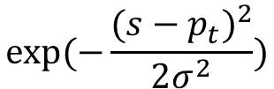
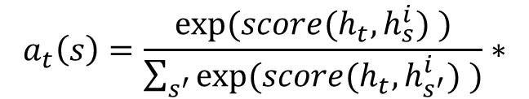


Local Attention
$$h_{s}$$
$${p_{t}=S∙sigmoid(v_{p}^{⊺}tanh⁡(W}_{p}h_{t}))$$
神经
$$h_{s}^{1}$$
A
$$window=[p_{t}−D,p_{t}+D]$$
机器
$$h_{s}^{2}$$
$$p_{t}$$
$$a_{t}\left(s\right)=\frac{exp⁡({score(h}_{t},h_{s}^{i}) )}{\sum_{s^{′}}{exp⁡({score(h}_{t},h_{s^{′}}^{i}) )}}∗$$
翻译
$$h_{s}^{3}$$
$$h_{t}$$
…
</s>
$$exp⁡(−\frac{⁡{(s−p_{t})}^{2}}{2σ^{2}})$$
$$h_{s}^{4}$$
<s>

Slide 28
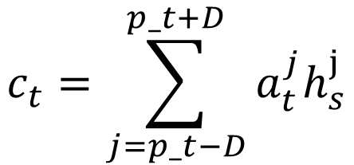



Local Attention
$$c_{t}=\sum_{j=p_t−D}^{p_t+D}{a_{t}^{j}h_{s}^{j}}$$
$$h_{s}$$
$$a_{t}^{1}$$
神经
$$h_{s}^{1}$$
C
$$a_{t}^{2}$$
A
机器
$$h_{s}^{2}$$
$$a_{t}^{3}$$
$$p_{t}$$
翻译
$$h_{s}^{3}$$
$$h_{t}$$
…
</s>
$$h_{s}^{4}$$
<s>

Slide 29


Softmax
$$h_{s}$$
$$a_{t}^{1}$$
神经
C
$${\tilde{h}}_{t}$$
$$h_{s}^{1}$$
$$a_{t}^{2}$$
A
机器
$$h_{s}^{2}$$
$$a_{t}^{3}$$
$$p_{t}$$
$${\tilde{h}}_{t}=tanh⁡(W\left[c_{t};h_{t}\right]+b)$$
翻译
$$h_{s}^{3}$$
$$h_{t}$$
…
</s>
$$h_{s}^{4}$$
<s>

Slide 30

Softmax
$${{p(y}_{t}|y_{<t},x)=softmax ⁡(W}_{s}{\tilde{h}}_{t}+b)$$
neural
Softmax
$$h_{s}$$
$$a_{t}^{1}$$
神经
C
$${\tilde{h}}_{t}$$
$$h_{s}^{1}$$
$$a_{t}^{2}$$
A
机器
$$h_{s}^{2}$$
$$a_{t}^{3}$$
$$p_{t}$$
翻译
$$h_{s}^{3}$$
$$h_{t}$$
…
</s>
$$h_{s}^{4}$$
<s>

Slide 31
Supervised Attention

Slide 32
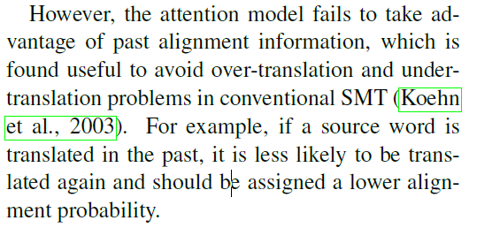
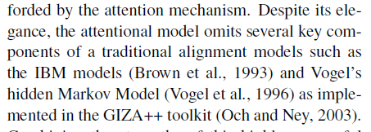
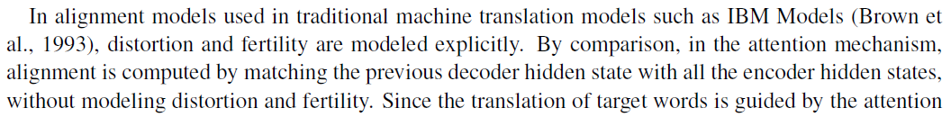
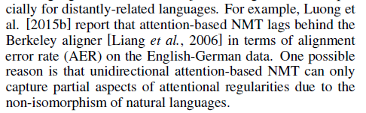
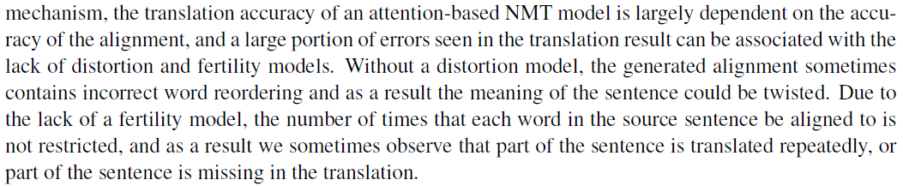
Shortcoming of Attention
Modeling Coverage for Neural Machine Translation
Incorporating Structural Alignment Biases into an Attentional Neural Translation Model
Agreement-Based Joint Training for Bidirectional Attention-Based Neural Machine Translation
Improving Attention Modeling with Implicit Distortion and Fertility for Machine Translation

Slide 33
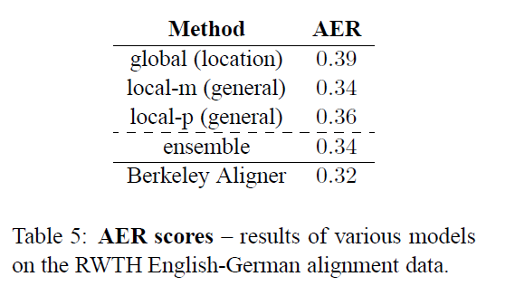
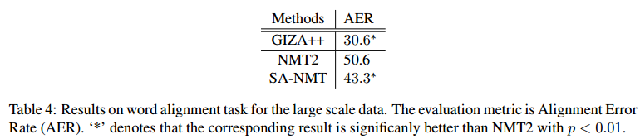
Attention’s Performance
Effective Approaches to Attention-based Neural Machine Translation
Neural Machine Translation with Supervised Attention
Alignment Error Rate (AER)
AER = 1 - (|A∩S| + |A∩P|) / (|A| + |S|)

Slide 34
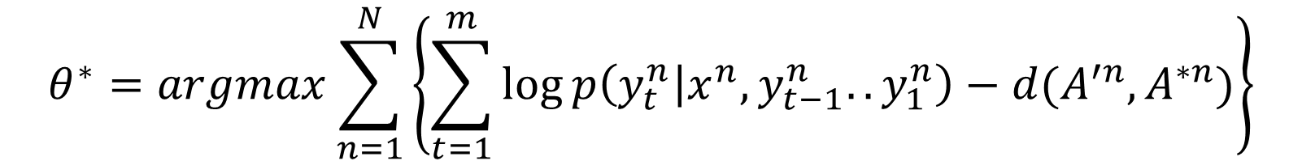
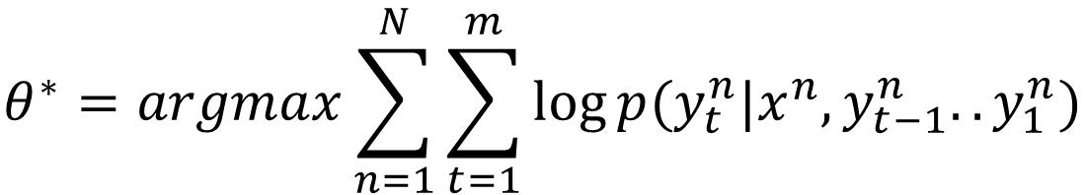
Supervised Attention’s Objective Function
$$θ^{∗}=argmax\sum_{n=1}^{N}{\sum_{t=1}^{m}{\log{p(y_{t}^{n}|x^{n},y_{t−1}^{n}..y_{1}^{n})}}}$$
$$θ^{∗}=argmax\sum_{n=1}^{N}{\left\{\sum_{t=1}^{m}{\log{p\left(y_{t}^{n} | x^{n},y_{t−1}^{n}..y_{1}^{n}\right)−d(A^{′n},A^{∗n})}}\right\}}$$

Slide 35
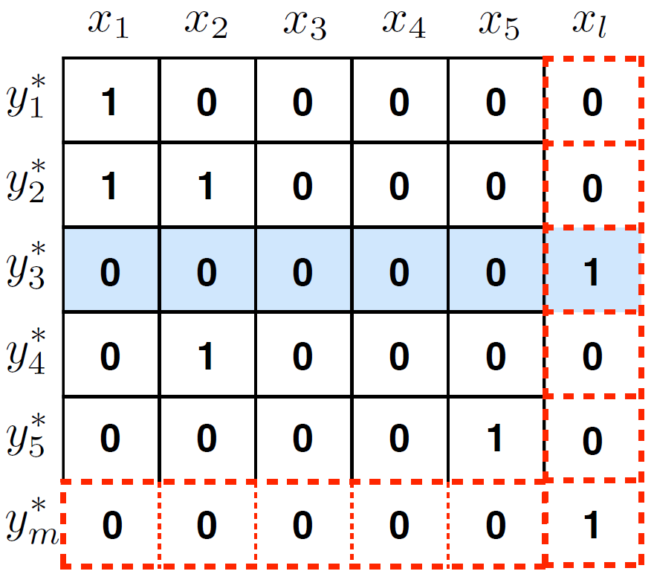
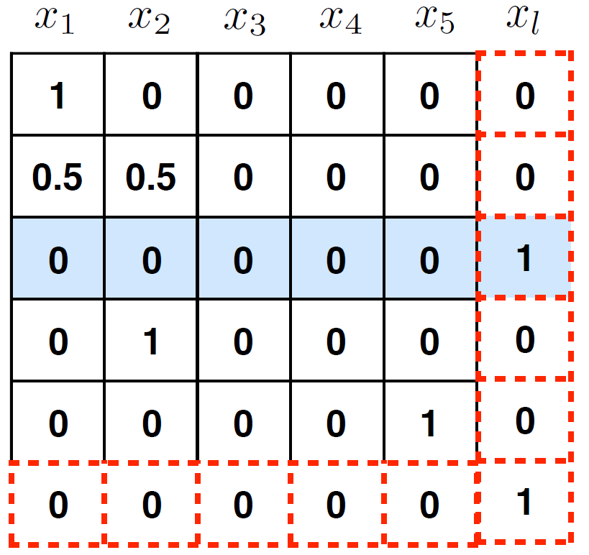
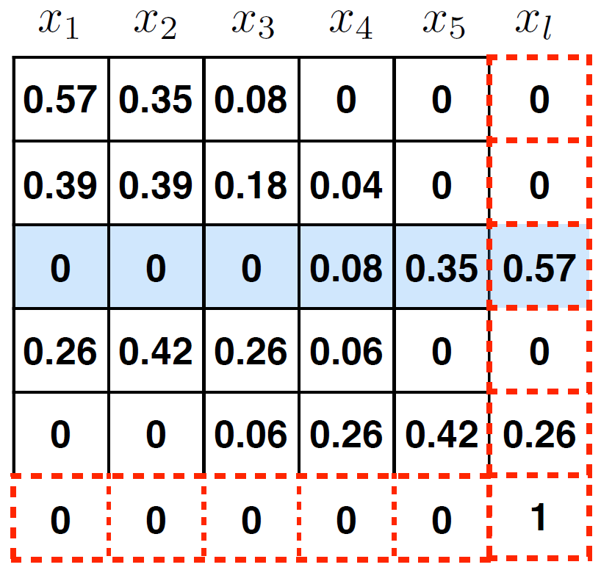
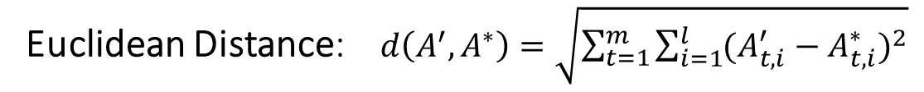
Quantify Alignment Disagreement
GIZA++ Alignment
GIZA++ Alignment normalization
Attention Alignment
Euclidean Distance: $d\left(A^{′},A^{∗}\right)=\sqrt{\sum_{t=1}^{m}{\sum_{i=1}^{l}{{(A_{t,i}^{′}−A_{t,i}^{∗})}^{2}}}}$

Slide 36
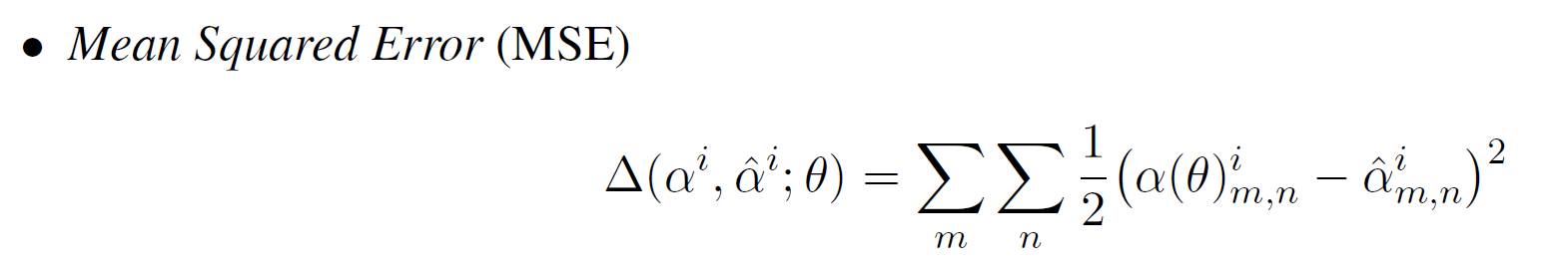
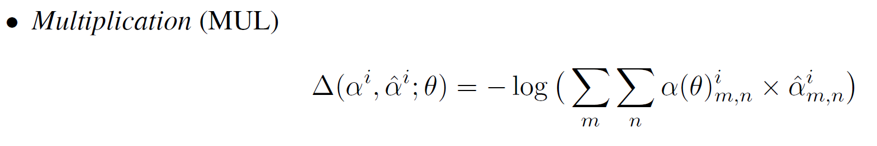
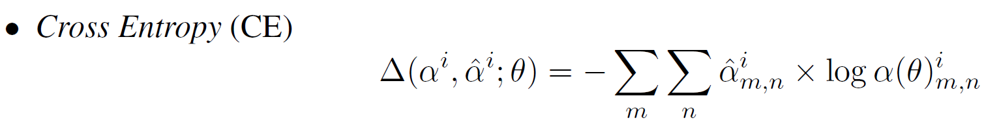
Quantify Alignment Disagreement

Slide 37
Thank you!

Slide 38
References
Luong M, Pham H H, Manning C D, et al. Effective Approaches to Attention-based Neural Machine Translation[C]. empirical methods in natural language processing, 2015: 1412-1421.
Mi H, Wang Z, Ittycheriah A, et al. Supervised Attentions for Neural Machine Translation[C]., 2016.
Liu L, Utiyama M, Finch A, et al. Neural Machine Translation with Supervised Attention[C]., 2016.
Tu Z, Lu Z, Liu Y, et al. Modeling Coverage for Neural Machine Translation[C]. meeting of the association for computational linguistics, 2016: 76-85.
Cohn T, Hoang C D, Vymolova E, et al. Incorporating Structural Alignment Biases into an Attentional Neural Translation Model[C]. north american chapter of the association for computational linguistics, 2016: 876-885.
Cheng Y, Wu H, Wu H, et al. Agreement-based joint training for bidirectional attention-based neural machine translation[C]// International Joint Conference on Artificial Intelligence. AAAI Press, 2016:2761-2767.
Liang P, Taskar B, Klein D, et al. Alignment by agreement[C]. north american chapter of the association for computational linguistics, 2006: 104-111.
Feng S, Liu S, Yang N, et al. Improving Attention Modeling with Implicit Distortion and Fertility for Machine Translation[J].

